Slide 1
Summary of 10 C++ item practice Chen Yuan Chung
1 Std::map and std::unorded_map
2 How to store/save a number to a file in binary mode? Not a string, and how to read that number from the file
3 There is a long string like “abc,def,ccd” how to split the string to three string by the “,”
4 If give you a 4X200 matrix(x1, x2, x3, x4), and one 1X200 vector( dependent variable), how to do the regression? How to get b1, b2, b3, b4
5 Every detail about std::shared_ptr
6 Every detail about std::vector
7 Get familiar with visual studio, write c++ code in visual studio
8 In windows, use c++ create your own dll, create another project to call these dll you generate
9 In windows, how to copile boost c++
10 Look at boost python, create in c++ and wrap the c++ with boost python, then call these c++ function in python.

Slide 2
1_map_unordered_map
Create map<char,int> , unordered_map<char,int>
Insert/erase/find elements
Use iterator to show content/insert elements/erase elements
Erase data immediately
Get the size of map
No duplicated key, keys are read-only
Hash table APIs for unordered map

Slide 3
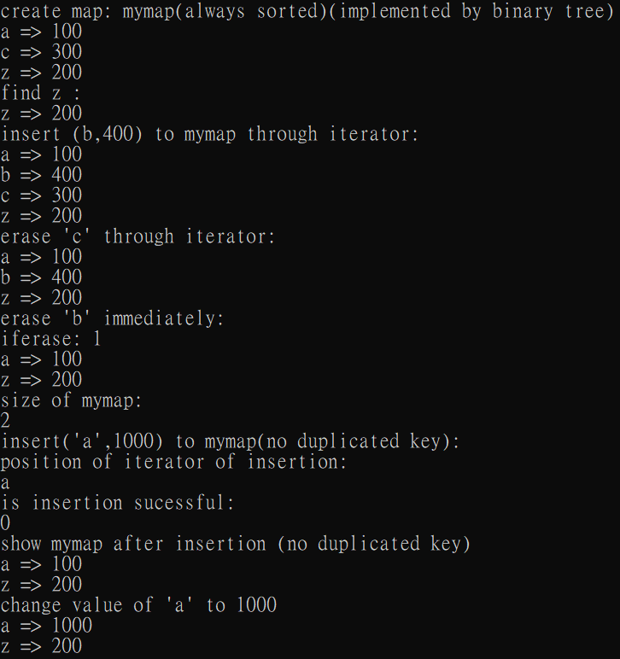
map

Slide 4
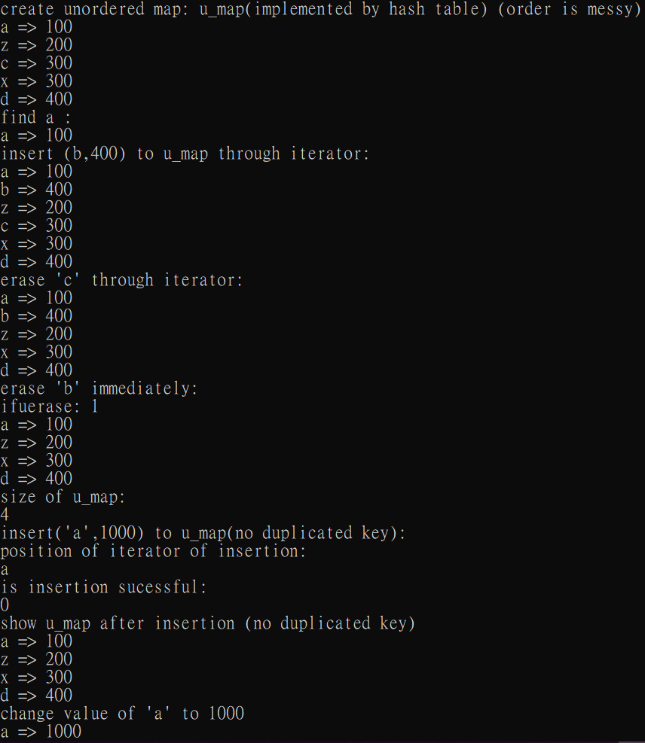
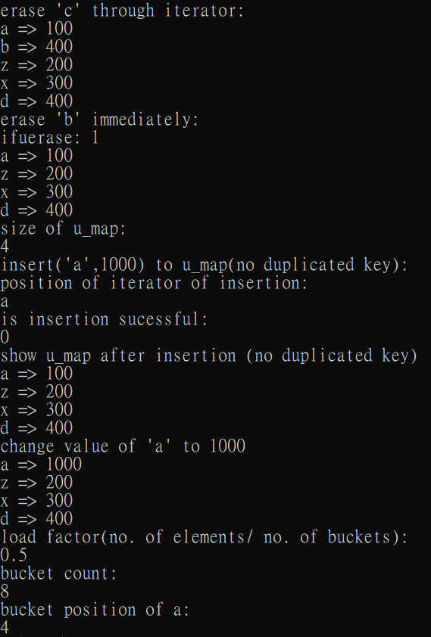
Unordered map

Slide 5
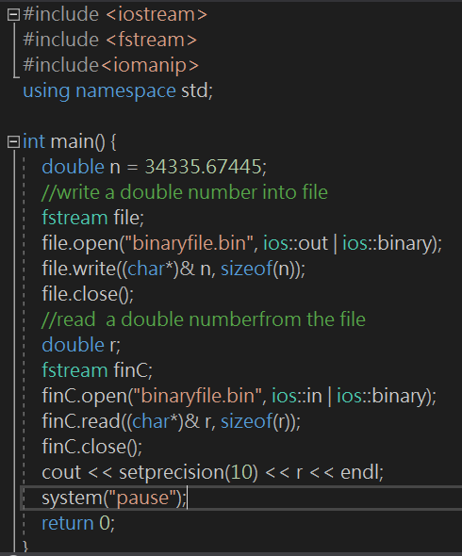
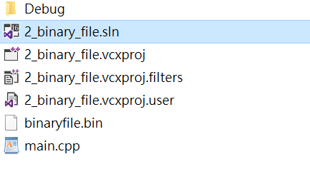
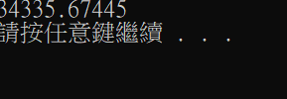
2_binary_file
Save n=34335.67445 into binaryfile.bin
Read a number from binaryfile.bin

Slide 6
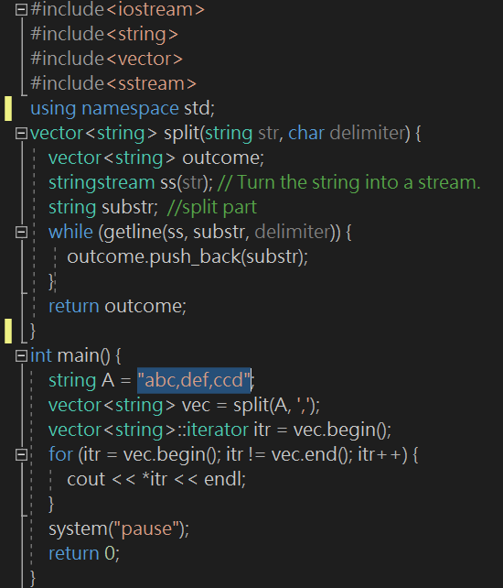
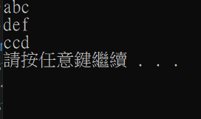
3_split_string
Split "abc,def,ccd“ with ,

Slide 7
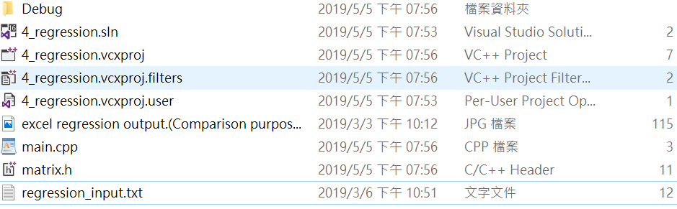
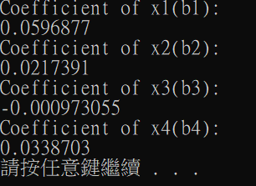
4_regression
Read data from regression_input.txt
regression_input.txt contains 4X200 matrix(x1, x2, x3, x4) and 1X200 matrix(y)
Implement code in matrix.h, main.cpp (only deal with correct input data)
Show the result of b1~b4 coefficeients

Slide 8
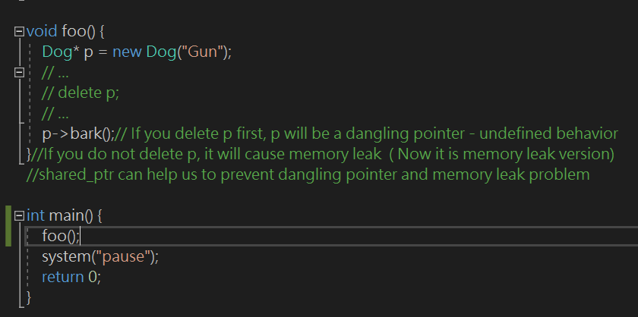
5_shared_ptr
1_why_shared_ptr
It is easy to have dangling pointer or undefined behavior without shared_ptr
p is dangling

Slide 9
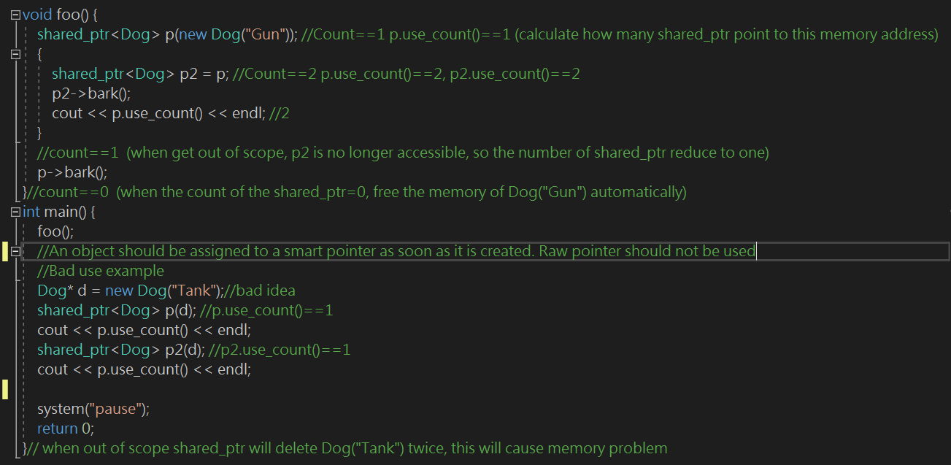
5_shared_ptr
2_Raw_pointer_shuold_not_be_used
This example in main shows undefined behavior(delete twice)

Slide 10
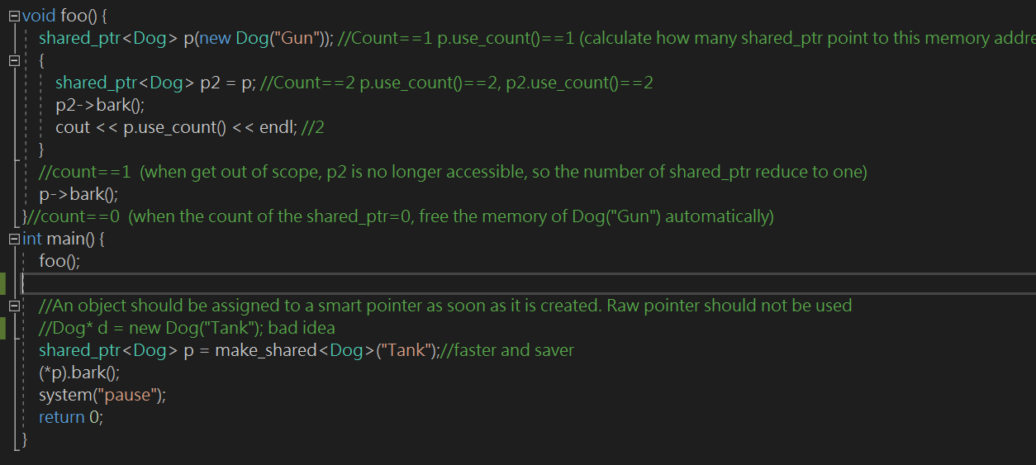
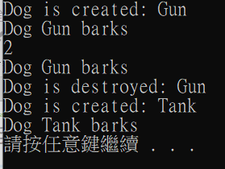
5_shared_ptr
3_replace_raw_pointer_with_make_shared
Execute foo() to practice use_count
Practice make_shared in main function

Slide 11
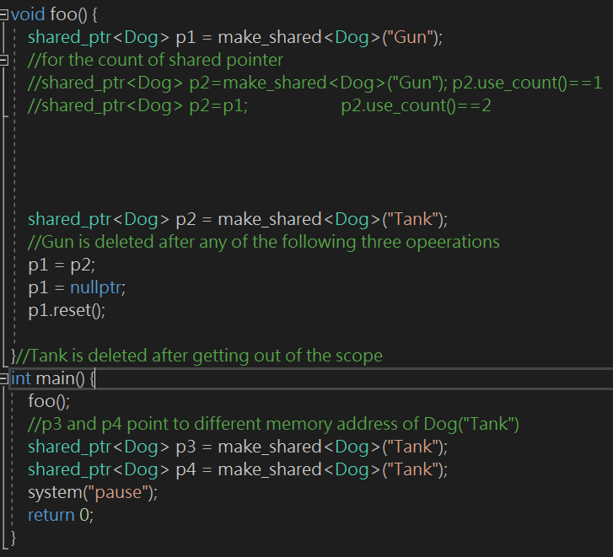
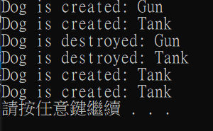
5_shared_ptr
4_use_of_make_shared
Foo() use make shared to manipulate shared_ptr
Main function create p3 and p4 pointing to different memory address of Dog("Tank")

Slide 12
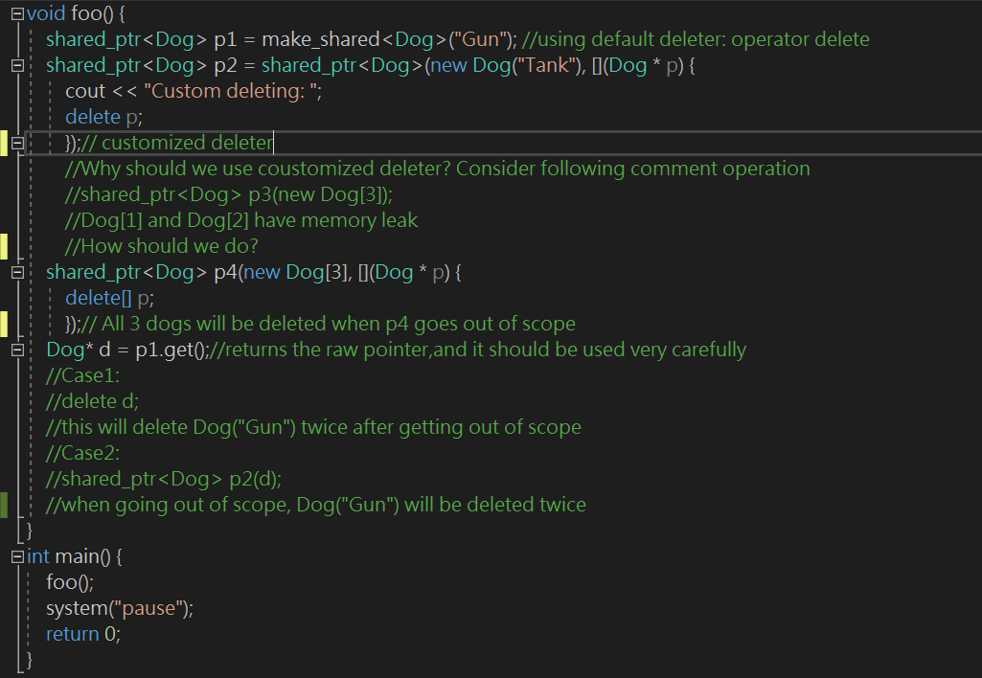
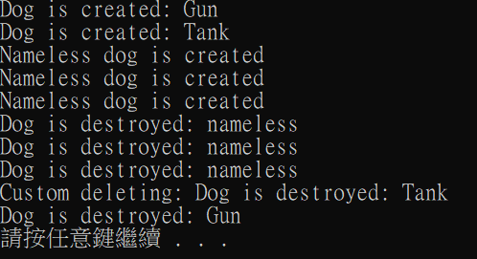
5_shared_ptr
5_use_of_customized_delete (comments in foo())

Slide 13
6_vector
vec={2,5,3} empty, capacity, size
When push_back elements exceed capacity, vector will allocate new memory space with bigger size and copy the data from old array to new memory space. After that, vector will push_back element in new array and delete memory space of old array
Copy construct vec2 from vec, clear, swap
Use iterator to print out elements, find, insert(before the position iterator point to) , and erase
Time complexity: insert/remove at beginning and middle position => O(n), insert/remove at end position => O(1), search ==> O(n)
Insert_iterator(insert vec3{3,4} into vec4{ 1,2,10,13 })
Reverse vec4
Algorithm(v{ 100,55,32,2,4,89,45,67 }): min_element, partial sort, partial reverse, insert from end

Slide 14
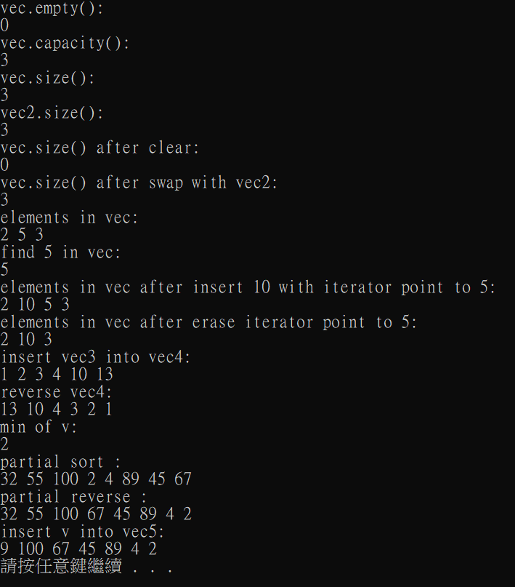
6_vector

Slide 15
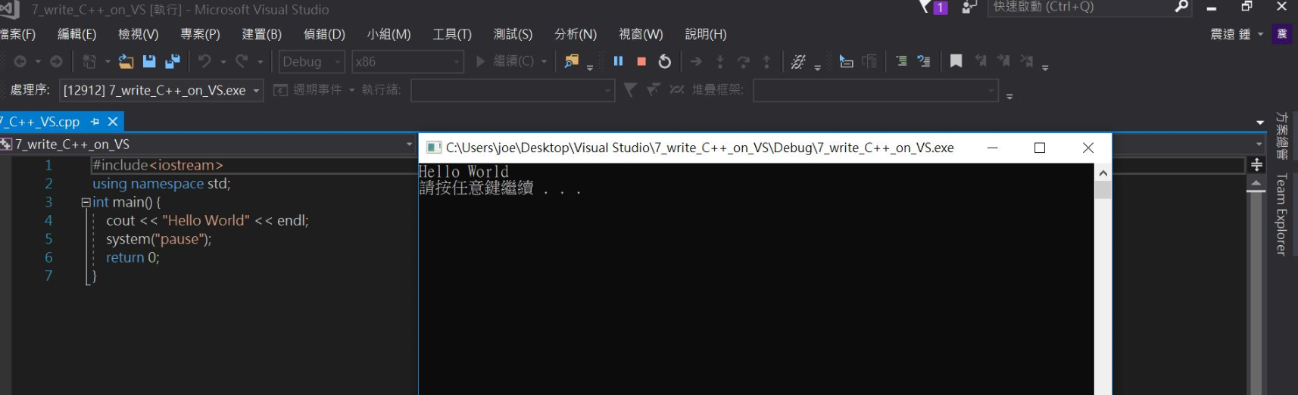
7_write_C++_on_VS
Try to use Visual Studio to finish every item
Upgrade Visual Studio 2017 to Visual Studio 2019
When you want to read txt file from other place in computer, you should copy the file into project and then add file in the project. (Item4 experience)
Ctrl+Shift+F can search and replace certain content in code

Slide 16
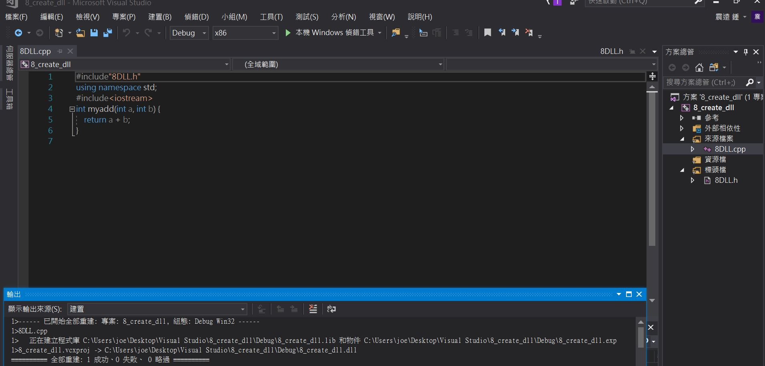
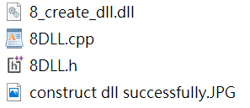
8_create_dll_call_dll
Construct dll successfully

Slide 17
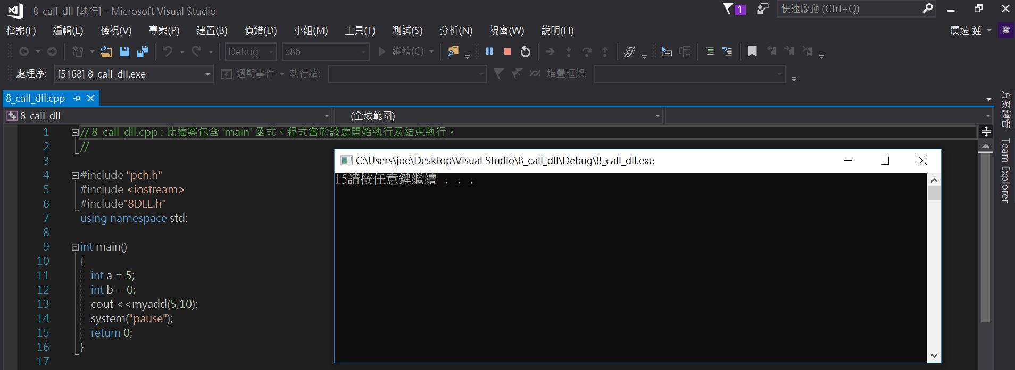
8_create_dll_call_dll
Call dll successfully

Slide 18
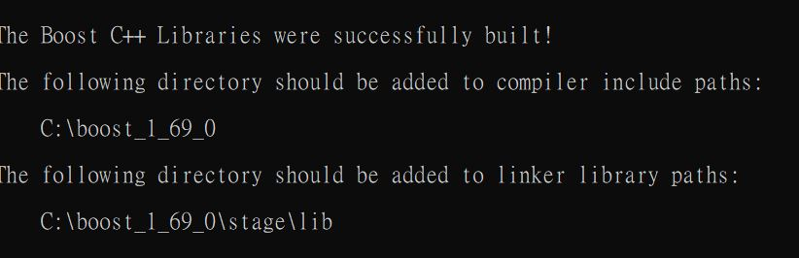
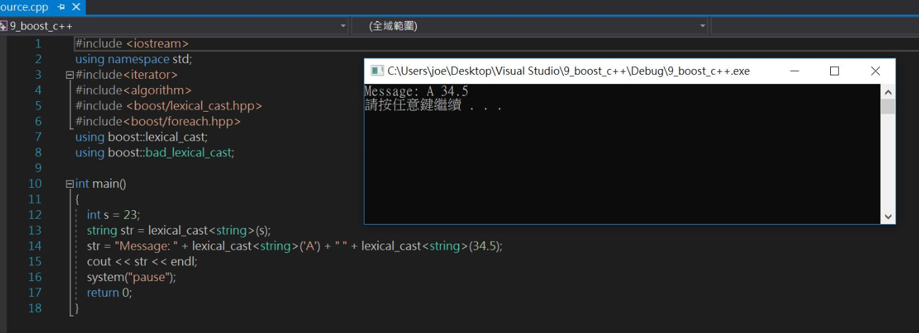
9_boost_c++
Path setting
Use boost library

Slide 19
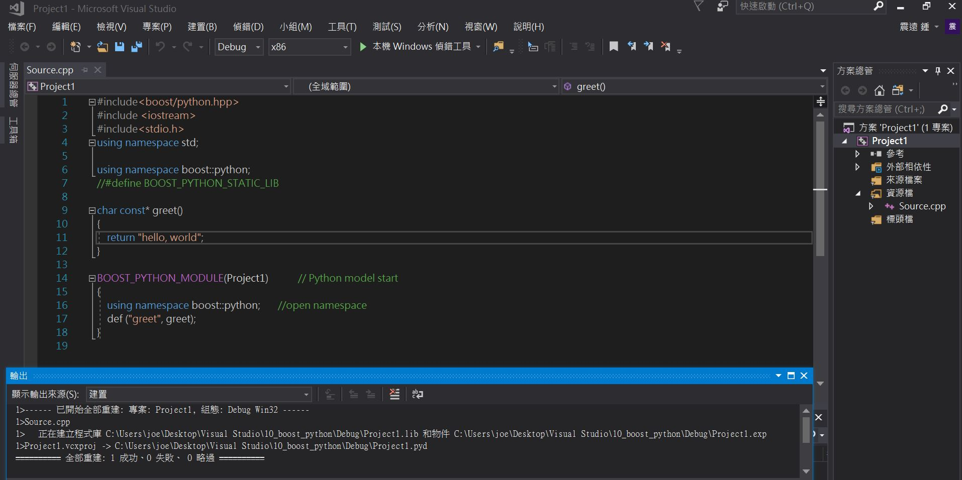
10_boost_python
Generate pyd file for python

Slide 20
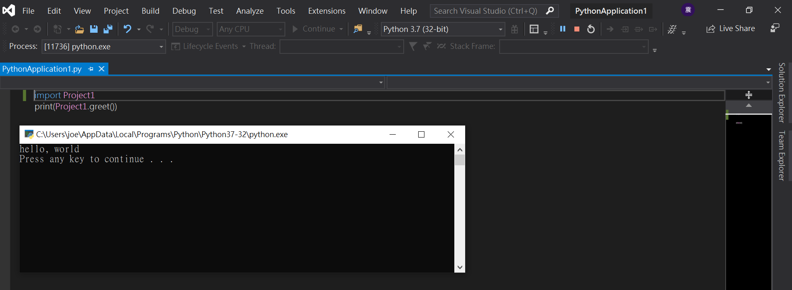
10_boost_python
Call C++ function in python

